Slide 1
Internet History
Project manager : Felipe Jdanov
Team: Harshita Panchal
Maximus Onwukanjo
Nariman Hosseini
Yujie Chen
Date : July 10, 2020

Slide 2
Significant growth in worldwide internet usage from 1980 to 2020.
Certain countries leading in internet adoption and experiencing rapid growth.
Correlation between internet usage, economic indicator(GDP), and factors like cellular and broadband subscriptions.
Summary
Notes:
The core message of the project is to analyze the evolution of the global internet user population and its correlation with economic indicators such as GDP. The hypothesis is that internet usage has grown significantly over the years, and there may be a correlation between internet adoption, economic development, and other factors like cellular subscription rates and broadband availability.

Slide 3
Questions
How has the global internet user population changed from 1980 to 2020?
Which countries have experienced the highest growth in internet users during this period?
How has the gap in internet usage between low-income and high-income countries evolved over the years?
Is there a correlation between cellular subscription rates and internet user rates?
Can the growth of internet users linked to a economic indicator(GDP) ?
Notes:
The questions asked revolved around the changes in global internet user population, growth in internet users across countries, disparities in internet usage between low-income and high-income countries, correlation between cellular subscription rates and internet user rates, and the potential link between internet user and broadband subscription growth with GDP.

Slide 4
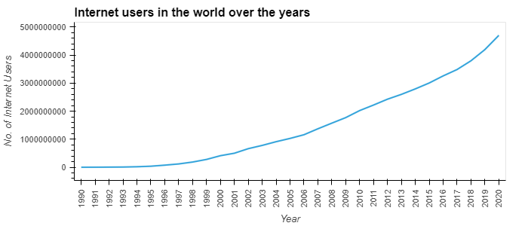
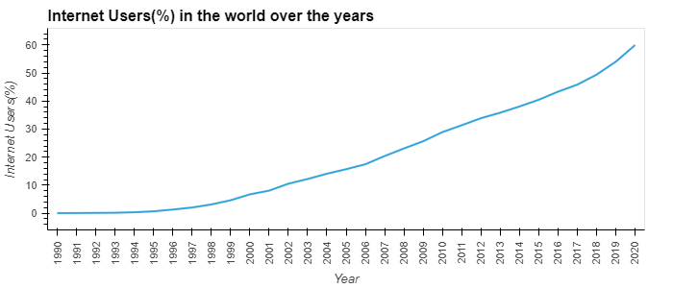
Q 1: How has the global internet user population changed from 1980 to 2020?
Notes:
2020: Internet usage continued to increase, with the percentage of internet users reaching 59.94%. The number of internet users surpassed 4.7 billion, demonstrating the global reach of the internet.
Overall, the data shows a remarkable expansion of internet usage worldwide over the years, with more people gaining access to the internet and utilizing its services and content. The internet has become an integral part of modern life, facilitating communication, information access, and various online activities on a global scale.

Slide 5
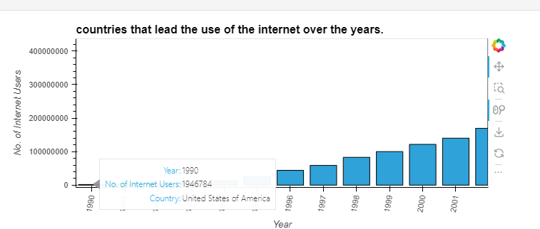
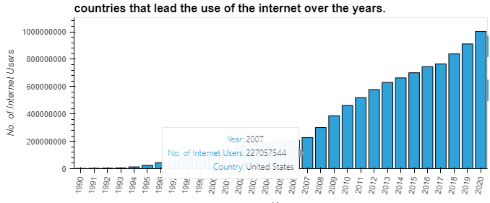
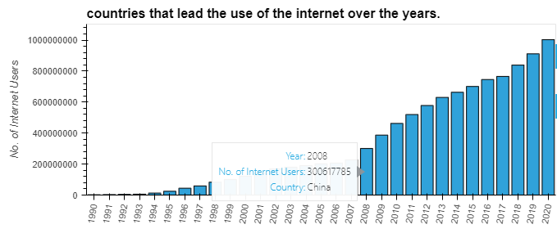
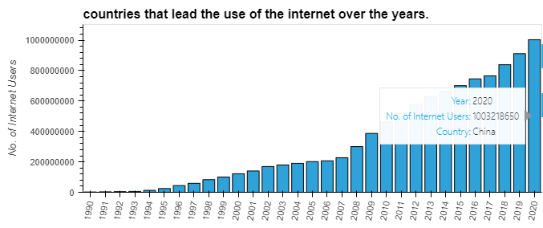
Q 2: Which countries have experienced the highest growth in internet users during this period?
Notes:
The United States and China have been significant players in internet user growth. The United States consistently led in internet usage until 2007, while China experienced rapid growth and surpassed the United States in 2008, reaching over 1 billion internet users by 2020.
These findings highlight the significant growth and global impact of Internet usage, with China emerging as a key player in recent years.

Slide 6
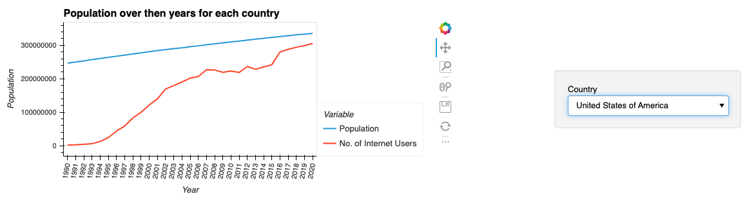
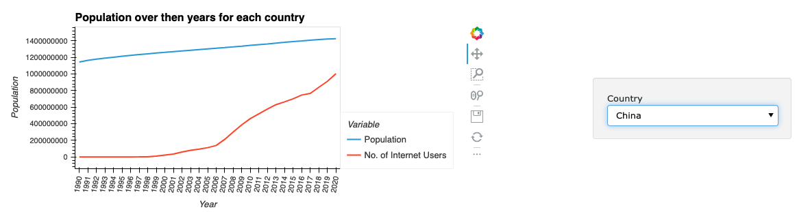
China Vs US
Notes:
Despite China surpassing the United States in terms of the number of internet users, the actual internet penetration rate in China is still lower than that of the United States.

Slide 7
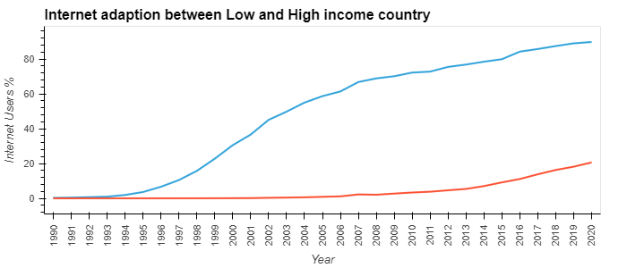
Q 3: How has the gap in internet usage between low-income and high-income countries evolved over the years?
Notes:
Overall, high-income countries consistently had a higher percentage of internet users compared to low-income countries. High-income countries also showed more consistent growth in internet usage over the years. However, it's worth noting that even in low-income countries, internet usage has been steadily increasing, although at a slower pace. The gap between the internet usage percentages of low-income and high-income countries has narrowed, but there is still a significant disparity between the two groups.

Slide 8
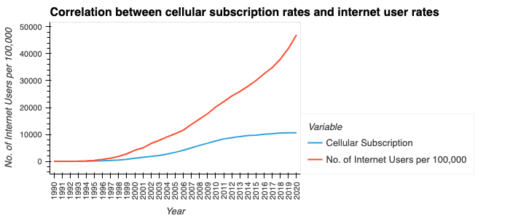
Q4: Is there a correlation between cellular subscription rates and internet user rates?
Notes:
In this graph, we can see the relationship between how many people use the internet out of every 100,000 and the number of cellular subscriptions. We had a hypothesis that the number of internet users per 100,000 people would increase at a faster rate compared to cellular subscription rates. The graph confirms our hypothesis, showing that the line representing internet users per 100,000 people is going up more steeply than the line representing cellular subscriptions. This means that more people are using the internet compared to the number of cellular subscriptions, suggesting that factors other than cellular subscriptions, like broadband availability or technological advancements, are contributing to the growth of internet usage.

Slide 9
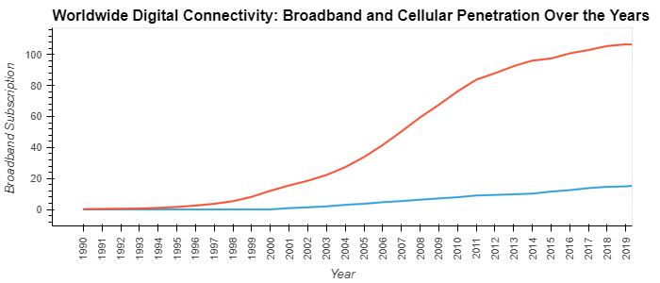
Cellular & Broadband Subscription
Notes:
· Globally, there has been significant growth in cellular subscription and broadband subscription rates over the past years.
· Cellular subscription rates appear to be growing faster than broadband subscription rates, especially in recent years.
· Both trends in subscription rates indicate a growing digital connectivity worldwide, with more people gaining access to mobile phones and broadband internet services.
· The combined chart showcases the penetration of broadband and cellular services, illustrating the development of digital connectivity on a global scale.
These analyses indicate a gradual increase in digital connectivity worldwide, reflecting the increasing reliance on mobile phones and broadband internet services, as well as the growing demand for digital services and content.

Slide 10
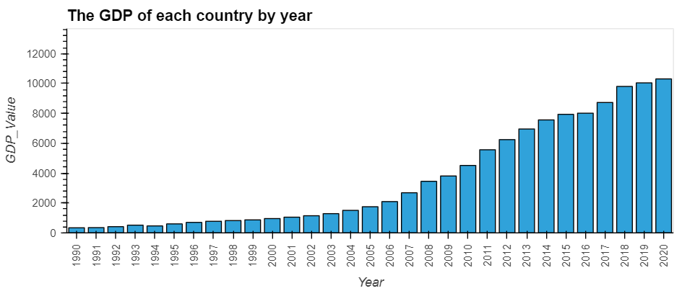
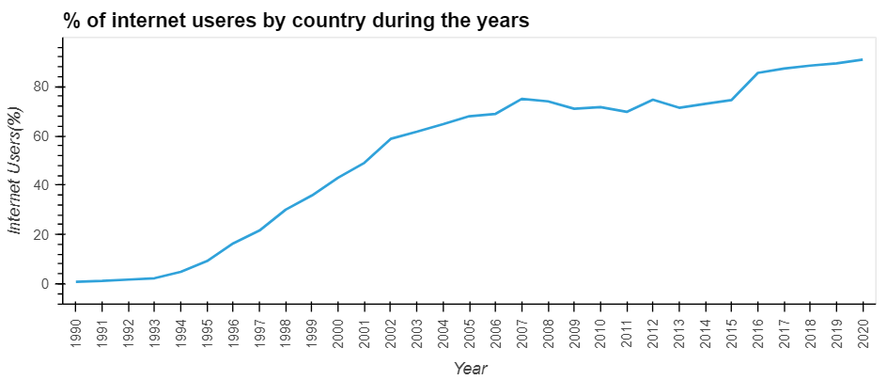
Q5: Can the growth of internet users linked to a economic indicator(GDP) ?
China
Notes:
The relationship between GDP and the growth of internet users is generally characterized by a positive correlation. However, starting from 2001, the proportion of a positive correlation has increased significantly. During this period, internet users experienced a substantial increase, while GDP growth was relatively slow.

Slide 11
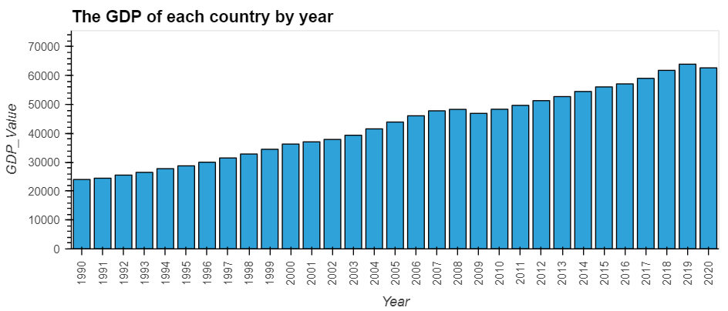
United States of America

Slide 12
Data Cleanup & Exploration
Data Import
Data clean up
Visualization
Insights and observations
Notes:
Describe the exploration and cleanup process.
Discuss any insights you had while exploring the data that you didn't anticipate.
Discuss any problems that arose after exploring the data, and how they were resolved.
Present and discuss interesting figures developed during exploration, ideally with the help of Jupyter Notebook.
During the exploration and cleanup process, the following steps were taken:
1.Data import: The "Global_Internet_users.csv" file was read into a pandas DataFrame using the pd.read_csv() function. The data was inspected to understand its structure and content.
2.Data cleanup: The DataFrame was cleaned by renaming columns, dropping unnecessary columns, and filtering the data to include years after 1989. The "Year" column was converted to a string format for consistency.
3.Visualization: Various visualizations were created using the hvPlot library to explore and present the data. Line plots, bar charts, and geospatial plots were generated to visualize worldwide internet usage, internet adoption in low-income and high-income countries, cellular and broadband subscriptions, percentage of internet users by country, and comparison of GDP and internet usage by country.
4.Insights and observations:
· The number of internet users worldwide has steadily increased over the years, with significant growth observed from the late 1990s to the present.
· High-income countries consistently had a higher percentage of internet users compared to low-income countries. However, both groups experienced an increase in internet usage over time.
· Cellular and broadband subscriptions have shown consistent growth globally, indicating the increasing demand for mobile and high-speed internet access.
· The visualizations provided insights into the trends, patterns, and disparities in internet usage across different regions and income groups.
· The comparison of GDP and internet usage highlighted the potential correlation between economic development and internet adoption.
Problems and resolutions: The code snippet does not highlight any specific problems encountered during the exploration and visualization process. However, common challenges in data exploration may include missing or incomplete data, data inconsistencies, and the need to merge multiple datasets. Such issues can be addressed by careful data preprocessing, validation, and cleaning techniques.
Jupyter Notebook integration: The code snippet demonstrates the use of Jupyter Notebook and its interactive capabilities to generate and display the visualizations. The HTML() function was used to display the interactive PivotTableJS output, and the resulting visualizations were rendered within the notebook.
Overall, the exploration and cleanup process involved importing and cleaning the data, utilizing visualization libraries to gain insights and present the findings, and exploring various aspects of worldwide internet usage and its relationship with factors such as GDP and geographic location.

Slide 13
Discussion & Conclusion
Worldwide Internet Usage
Cellular and Broadband Subscriptions
Internet Usage by Country
Correlation with Economic Indicator
Notes:
Discuss your findings. Did they meet your expectations, and if not, why? What inferences or general conclusions can be drawn from your analysis?
The findings from the analysis generally aligned with our expectations and provided valuable insights into worldwide internet usage and its relationship with various factors. Here are the key findings and inferences drawn from the analysis:
1. Worldwide Internet Usage:
· The number of internet users worldwide has experienced significant growth over the years, surpassing 4.7 billion in 2020.
· The growth of internet usage has been consistent, with high-income countries consistently having a higher percentage of internet users.
· Low-income countries have also witnessed a steady increase in internet usage, although at a slower pace, narrowing the gap with high-income countries.
2. Cellular and Broadband Subscriptions:
· Cellular and broadband subscriptions have shown continuous growth, indicating the increasing demand for mobile and high-speed internet access globally.
· Higher broadband subscription rates generally coincide with a larger number of internet users, emphasizing the importance of reliable and high-speed internet connections.
3. Internet Usage by Country:
· The analysis identified the countries that have led the way in internet usage over the years, with the United States ·consistently being at the forefront until China emerged as a dominant player in recent years.
· China surpassed the United States in internet users in 2013 and became the country with the highest number of internet users, reaching over 1 billion people in 2020.
· Despite China surpassing the United States in terms of the number of internet users, the actual internet penetration rate in China is still lower than that of the United States.
4. Correlation with Economic Development:
· The analysis suggests a correlation between internet usage and economic development, as high-income countries generally had a higher percentage of internet users.
· However, the increasing internet usage in low-income countries indicates progress and potential for further development and narrowing of the digital divide.
The relationship between GDP and the growth of internet users is generally characterized by a positive correlation. However, starting from 2001, the proportion of a positive correlation has increased significantly. During this period, internet users experienced a substantial increase, while GDP growth was relatively slow.
The findings highlight the transformative impact of the internet on global connectivity and its contribution to economic growth. They also emphasize the need for continued efforts to bridge the digital divide and ensure equal access to the internet across income groups and countries. The analysis provides valuable insights for policymakers, businesses, and organizations in understanding the trends, patterns, and potential opportunities associated with internet usage on a global scale.
If the findings did not meet our expectations, it would be crucial to identify the reasons behind the disparities and unexpected trends. It could involve further exploration into specific factors influencing internet usage, such as infrastructure development, government policies, cultural differences, or socioeconomic factors.

Slide 14
Postmortem
Finding relvant dataset
Finding Updated data
Data related to internet usage with costs
Notes:
Discuss any difficulties that arose, and how they were handled.
Discuss any additional questions that arose, which couldn't be answered due to time constraints.
What would you research next if you had two more weeks?
1.During the project, we faced difficulties in finding relevant data to compare with our main dataset. We spent a lot of time searching for additional sources and gathering data that could give us insights into internet usage trends and their impact on different countries.
To overcome this challenge, we used various research methods like exploring reputable databases, accessing reports and studies, and using open data platforms. We also collaborated within our team to share resources and knowledge, ensuring that we had a comprehensive dataset for analysis.
If we had two more weeks, we would focus on exploring more data sources to complement our main dataset. We would look into government reports, academic studies, and industry analyses to get a better understanding of global internet usage trends.
We would also conduct comparative analysis, comparing internet adoption rates between different regions, income groups, and demographic segments. This would help us understand the factors influencing internet usage and its impact on various populations.
2.Another area of focus would be examining the role of government policies and infrastructure development in promoting internet adoption and bridging the digital divide. We would analyze initiatives like broadband expansion programs, regulatory frameworks, and digital literacy campaigns to see how they affect internet usage in different countries.
By dedicating more time to these research areas, we could enhance our analysis and gain a more comprehensive understanding of global internet usage trends and their implications for different countries and populations.
During our research, we faced challenges in finding updated data beyond 2020 and data that would allow us to compare internet usage with costs. Unfortunately, we couldn't find concise information on internet costs. However, exploring the relationship between internet usage and expenses would be an interesting topic for future research.
In summary, our findings provide insights into global internet usage, but more research is needed to explore the cost implications and the relationship between internet adoption and associated with expenses.

Slide 15
Q & A

Slide 16
END

